Slide 1
Data Structures & Algorithms (CSC-214)
Hash tables

Slide 2
Hash tables
Performance improved as we went on from linear structures to binary trees
Hash tables provide even better performance ~ O(1)
Idea: Transforming input (key) into a fixed-size value (hash code).

Slide 3
Hash tables
Input data is stored with a key
Use a unique mapping of each key onto a specific location in an array
The mapping of the key to a specific location in an array is handled by the hash operation

Slide 4

Hash operations
Input: Key
Output: Integer that is used to index into the hash table
The key is an integer
Key = 3, place in index 3
Key = 1, place in index 1
Key = 9?

Slide 5
Hash operations
Key = 9?
Need to perform some operation on the key so it can be mapped onto a valid array
Simplest solution:
Any ideas?

Slide 6
Hash operations
Key = 9?
Need to perform some operation on the key so it can be mapped onto a valid array
Simplest solution:
Use mod on table/array size
Key = 9
Table Size = 7
9 mod 7 = 2

Slide 7
Hash operations
Issue with mod?
Collision: when the hash calculation generates the same index value for more than one key
Key = 1
1 mod 7 = 1
Key = 3
3 mod 7 = 3
Key = 10
10 mod 7 = 3
Solution of collision?
Chaining
One of the solutions for such collisions
All the keys that generate a particular index are connected to that array position in a chain — or another data structure

Slide 8
Hash operations
One way to implement chaining is by associating a binary search tree with each table entry
At 0, there would be a BST of all elements for which the hash produces a 0
At 1, there would be a BST of all elements for which the hash produces a 1
…
Upto 6

Slide 9

Hash operations – Example (1)
Key Value Insertion Order: 1, 3, 7, 8, 10, 13
Index = Key Mod 7

Slide 10
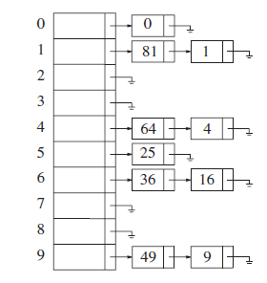
Hash operations – Example (2)
Keep a list of all elements that hash to the same value
Assume
Keys are first 10 perfect squares
Hashing function:
Hash(x) = x mod 10

Slide 11
Chaining with Lists - Searching
Use the hash function to determine which list to traverse
Search the appropriate list: see whether the element is already in place
If the element turns out to be new, it can be inserted at the front of the list, since it is convenient and also because frequently it happens that recently inserted elements are the most likely to be accessed in the near future

Slide 12
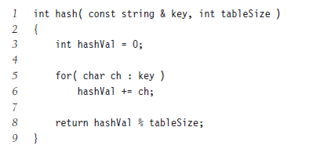
Index Generation more Complex for Non-Integer Keys
For string, e.g., add up ASCII values of all the characters
“smith”
=115(s)+109(m)+105(i)+116(t)+104(h)
= 549
Complexity comes in when trying to create uniform distribution of data items throughout the table

Slide 13
Index Generation more Complex for Non-Integer Keys
For real numbers:
Truncating (not advised)
std::hash<float>
Multiply the float by a large constant to shift the decimal places into the integer range (be careful of integer overflow)
How to handle negative input values
Double mod: hash = ((key % tableSize) + tableSize) % tableSize;

Slide 14
Hash tables – Issue (1)
Does not distribute keys well for large tables though
Table size = 10,007 (prime numbers usually used)
All keys are 8 or fewer characters long
Char values max up to 127
127 * 8 = 1,016 max key value

Slide 15
Hash tables – Issue (2)
Assume key is at least 3 chars long
27 = 26 alphabets + space
For random three letters, distribution in 10,007 size is fine
But,
English is not random
26 x 26 x 26 = 17, 576 possibilities
Real dictionary distribution yields only 2,851 possibilities, which again does not utilize a table of size 10,007 well

Slide 16
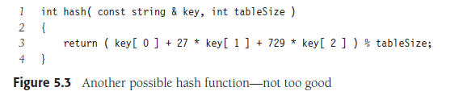
Hash tables – Issue (2)
If you know keys are always exactly 3 lowercase letters or space (27 possible symbols), and want something faster/simpler:
Choose tableSize = 2851 or a nearby prime for best utilization.

Slide 17
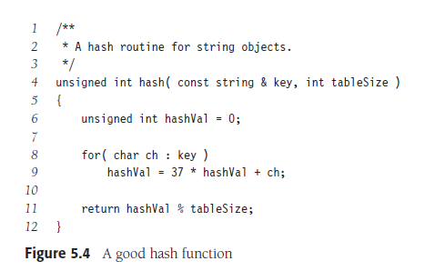
Hash functions
Primes like 31, 33, or 37 are commonly used for their low collision rates in English-like text.
A good hash function
May run into issues if the input size is restricted

Slide 18
Hash tables – Issue (3)
When designing a hash table, especially for storing or looking up English:
Random Distribution Assumption fails.
The real-world data is skewed: some prefixes (like "the", "con", "pre") are very common, while many others never appear at all.
This makes a large table like size (sparse), especially if you're only storing ~2,851 entries. 10,007 underutilized
Load Factor = 2,851/10,007 ≈ 0.285 - quite sparse (low utilization).
You can reduce the table size to something closer to the actual data volume:
Nearest prime ≥ 2,851: 2,857 (or choose a slightly larger prime like 3,001)
This improves cache locality and reduces memory waste

Slide 19
Hash tables – Recap (1)
Transforming input (key) into a fixed-size value (hash code)
Purpose: Efficient data access — ideally constant time O(1)
Hash Functions: Deterministic, Uniform distribution, Fast computation
Common Hash functions: Modulo-based, Polynomial rolling, std::hash
Edge cases: poor distribution, clustering, integer overflow

Slide 20
Hash tables – Recap(2)
Array of fixed size with key-value pairs.
Operations: Insert, search, delete
Load Factor (α):
α = Number of elements/Table size
Affects performance.
Resize if α > threshold (e.g., 0.7).
Collisions: Multiple keys map to same index
Resolution Strategies:
Open Addressing
Linear Probing: (hash + i) % size
Others (won’t be covering)
Chaining
Each slot holds a linked list (or vector)
Simpler to implement, especially in C++.

Slide 21
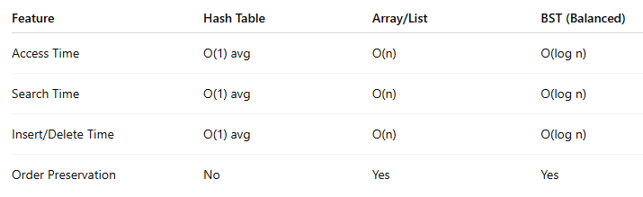
Hash Tables – Recap (5)
Real Life Applications
Databases: Indexing
Password Storage: With cryptographic hashing
User passwords are hashed using secure hash functions (e.g., SHA-256).
Stored hashes are compared (not the original password) during login to prevent leaks.
Spell Checkers

Slide 22
Any Questions?

